Slide 1



Lake Surface Area Changes in the Enriquillo Basin
Scientific Causes
& Where we go from here?
Jorge E González (CCNY)
Daniel Comarazamy (CCNY)
Equisha Glen (CCNY)
Ricardo González (INTEC)
Julio Roman (Medio Ambiente)
July 28, 2012
Instituto Tecnológico de Santo Domingo (INTEC)
The NOAA CREST Center of the City College of New York (CCNY)

Slide 2
Outline
Background
Lake Surface Area Analysis
Analysis of Meteorological Variables
Land Use Analysis
Hypotheses
Testing the Hypothesis
  Local observations
  Modeling
Recommendations

Slide 3
Background
The Enriquillo and Sumatre lakes are saltwater lakes located in a rift valley that is a former marine strait created around 1 million years ago when the water level fell and the strait was filled in by river sediments.
Lake Enriquillo is in the Dominican Republic, it is the largest lake and lowest point in the Caribbean, and the lowest point on any ocean island.
Lake Sumatra is the largest lake in Haiti and the second largest lake of La Hispaniola, the brackish water lake is a twin of the Enriquillo Lake.
Lake size has increased about 50% from 2004 to 2011, flooding communities.
In 2010, INTEC contacted CCNY/CREST to support in researching the causes for the Lakes’ Growth Rates.
CCNY allocated seed resources to support the effort.

Slide 4
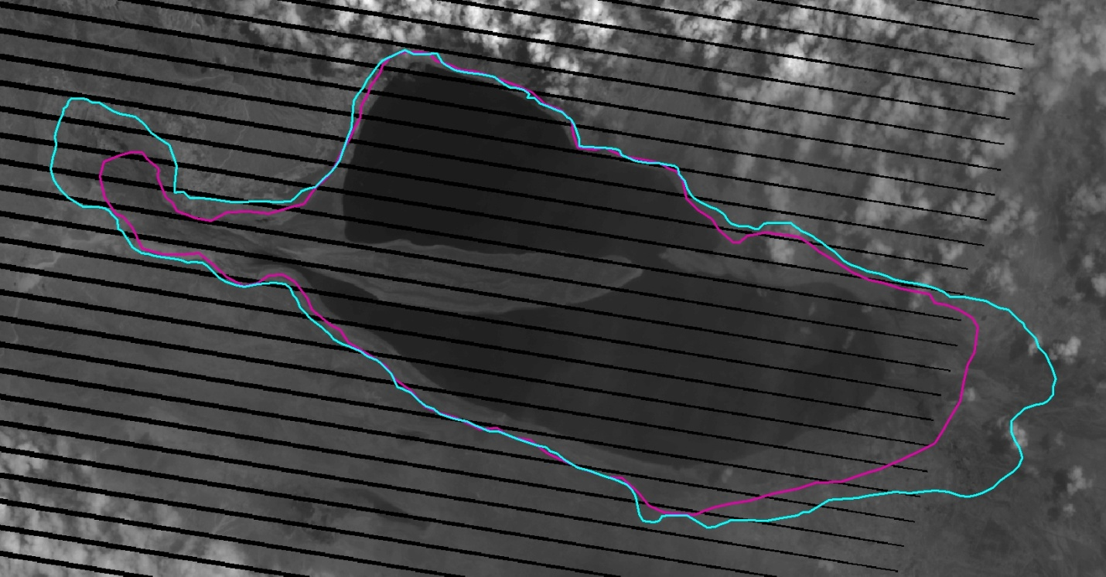
Lake Enriquillo Surface Area Analysis
Border of Lake in 1984, 2004, and 2009
Base map is image of 2004, where la Isla Cabritos is connected to the coast at 2004
Red border is lake at 1984
Blue border is lake at 2009 (la Isla Barbarita and la Islita are submerged)

Slide 5
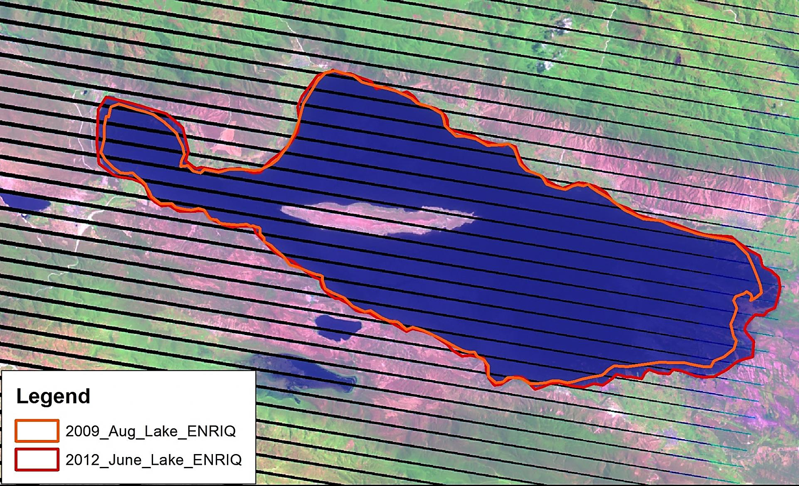
Lake Enriquillo Surface Area Analysis
Border of Lake in 2009 and 2012

Slide 6
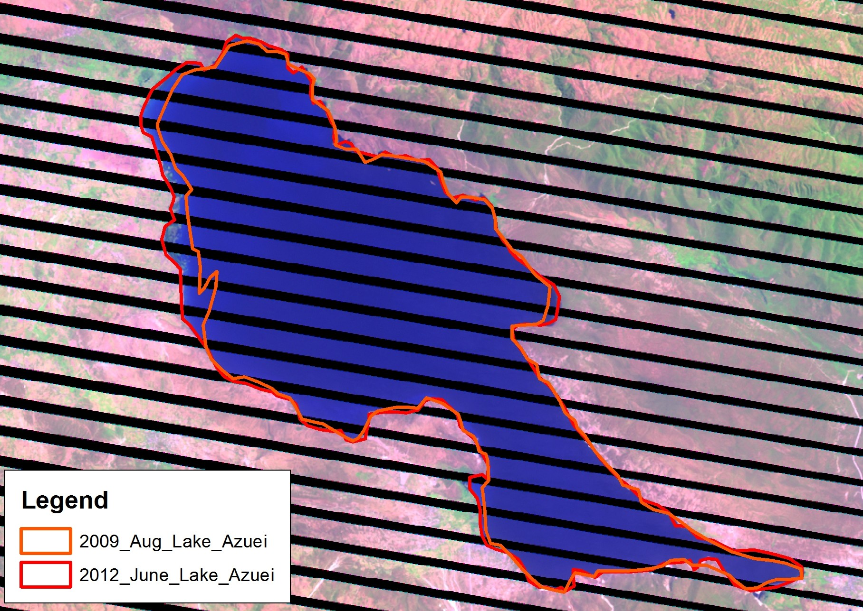
Lake Sumatre Surface Area Analysis
Border of Lake in 2009 and 2012

Slide 7
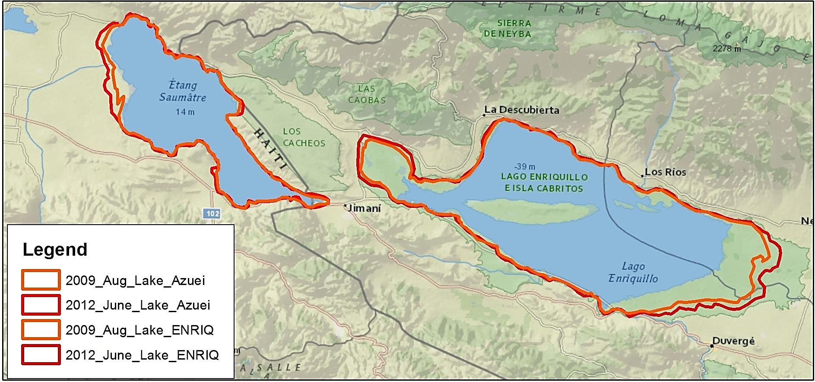
Lakes Surface Area Analysis
Border of Lakes in 2009 and 2012
Both show an ~7% increase in 3 years

Slide 8
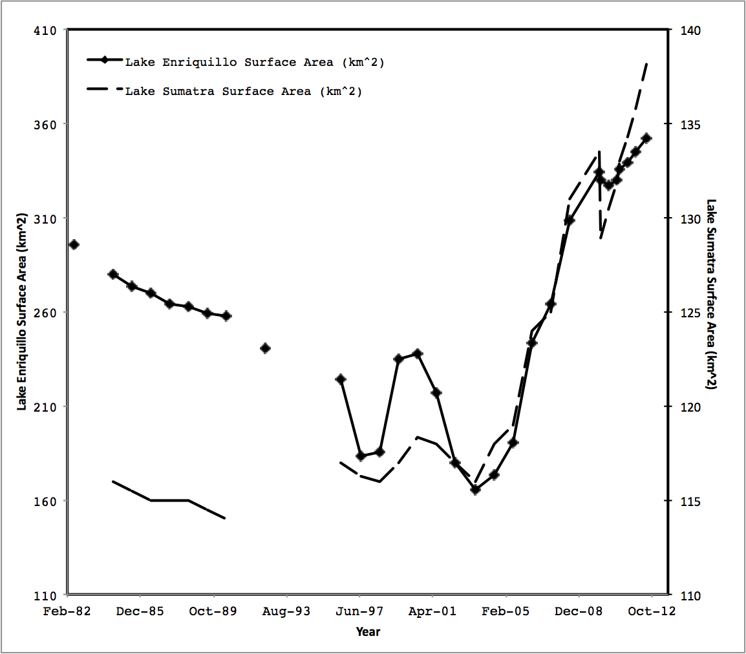
Average Enriquillo and Sumatre Lakes Surface Area 1982-June 2012

Slide 9
Average Lake Surface Area 1984-2011:
Some Numbers
Enriquillo Saumatre
The lake grows back to its size of 1984 (276 km ² ) at around year 2006
The smallest surface area was recorded at 2004 with surface area of 165 km ² .
Size of the lake at the end of 2011 was 331 km² , this is 17%. larger than size at 1984, and 2Xlarger than size in 2004.
Shows a general increasing trend from 1984 to 2010
Area at 1984 was 115.96 km²
Area at May 2010 was 134.26 km²
15.8% increased in past 25 years.

Slide 10
Local Precipitation: Monthly Average
Climatological Seasonal Variation (Barahona & Santo Domingo)
  Dry season: December to March
  Early rainfall: May to June
  Late rainfall: August to November

Slide 11
Local Precipitation: 10-year Seasonal Variation
10% and 16% increase in early and late fall season, respectively, between 1980-1989 and 2000-2009 period
15% decrease in rainfall for dry season between 1980-1989 and 2000-2009 period

Slide 12
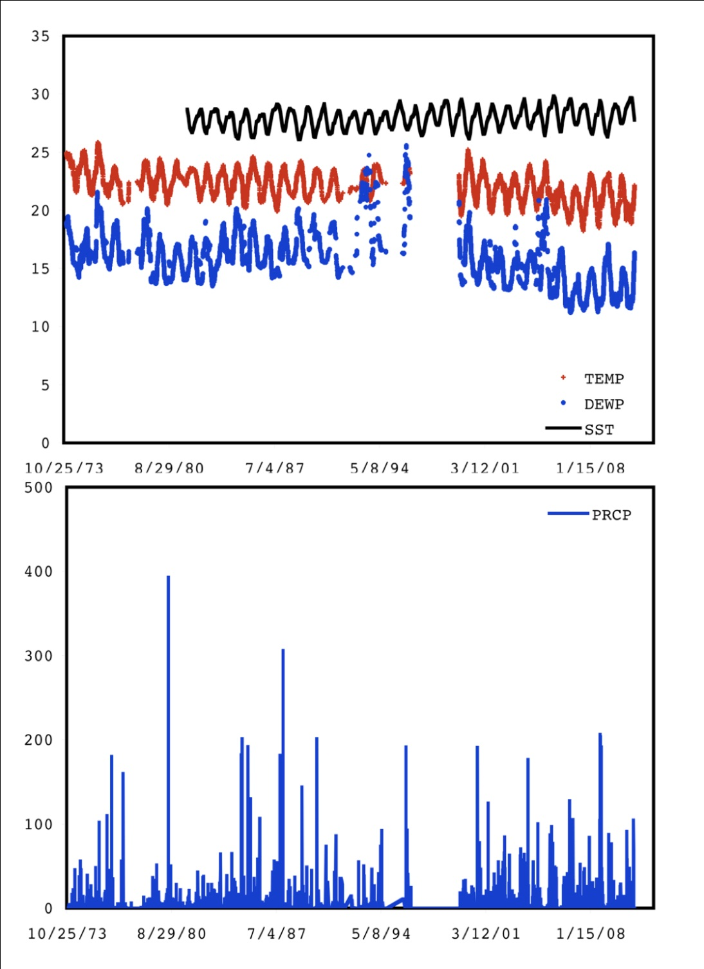
Why is the Surface Area of the Lakes Changing Dramatically?

Slide 13
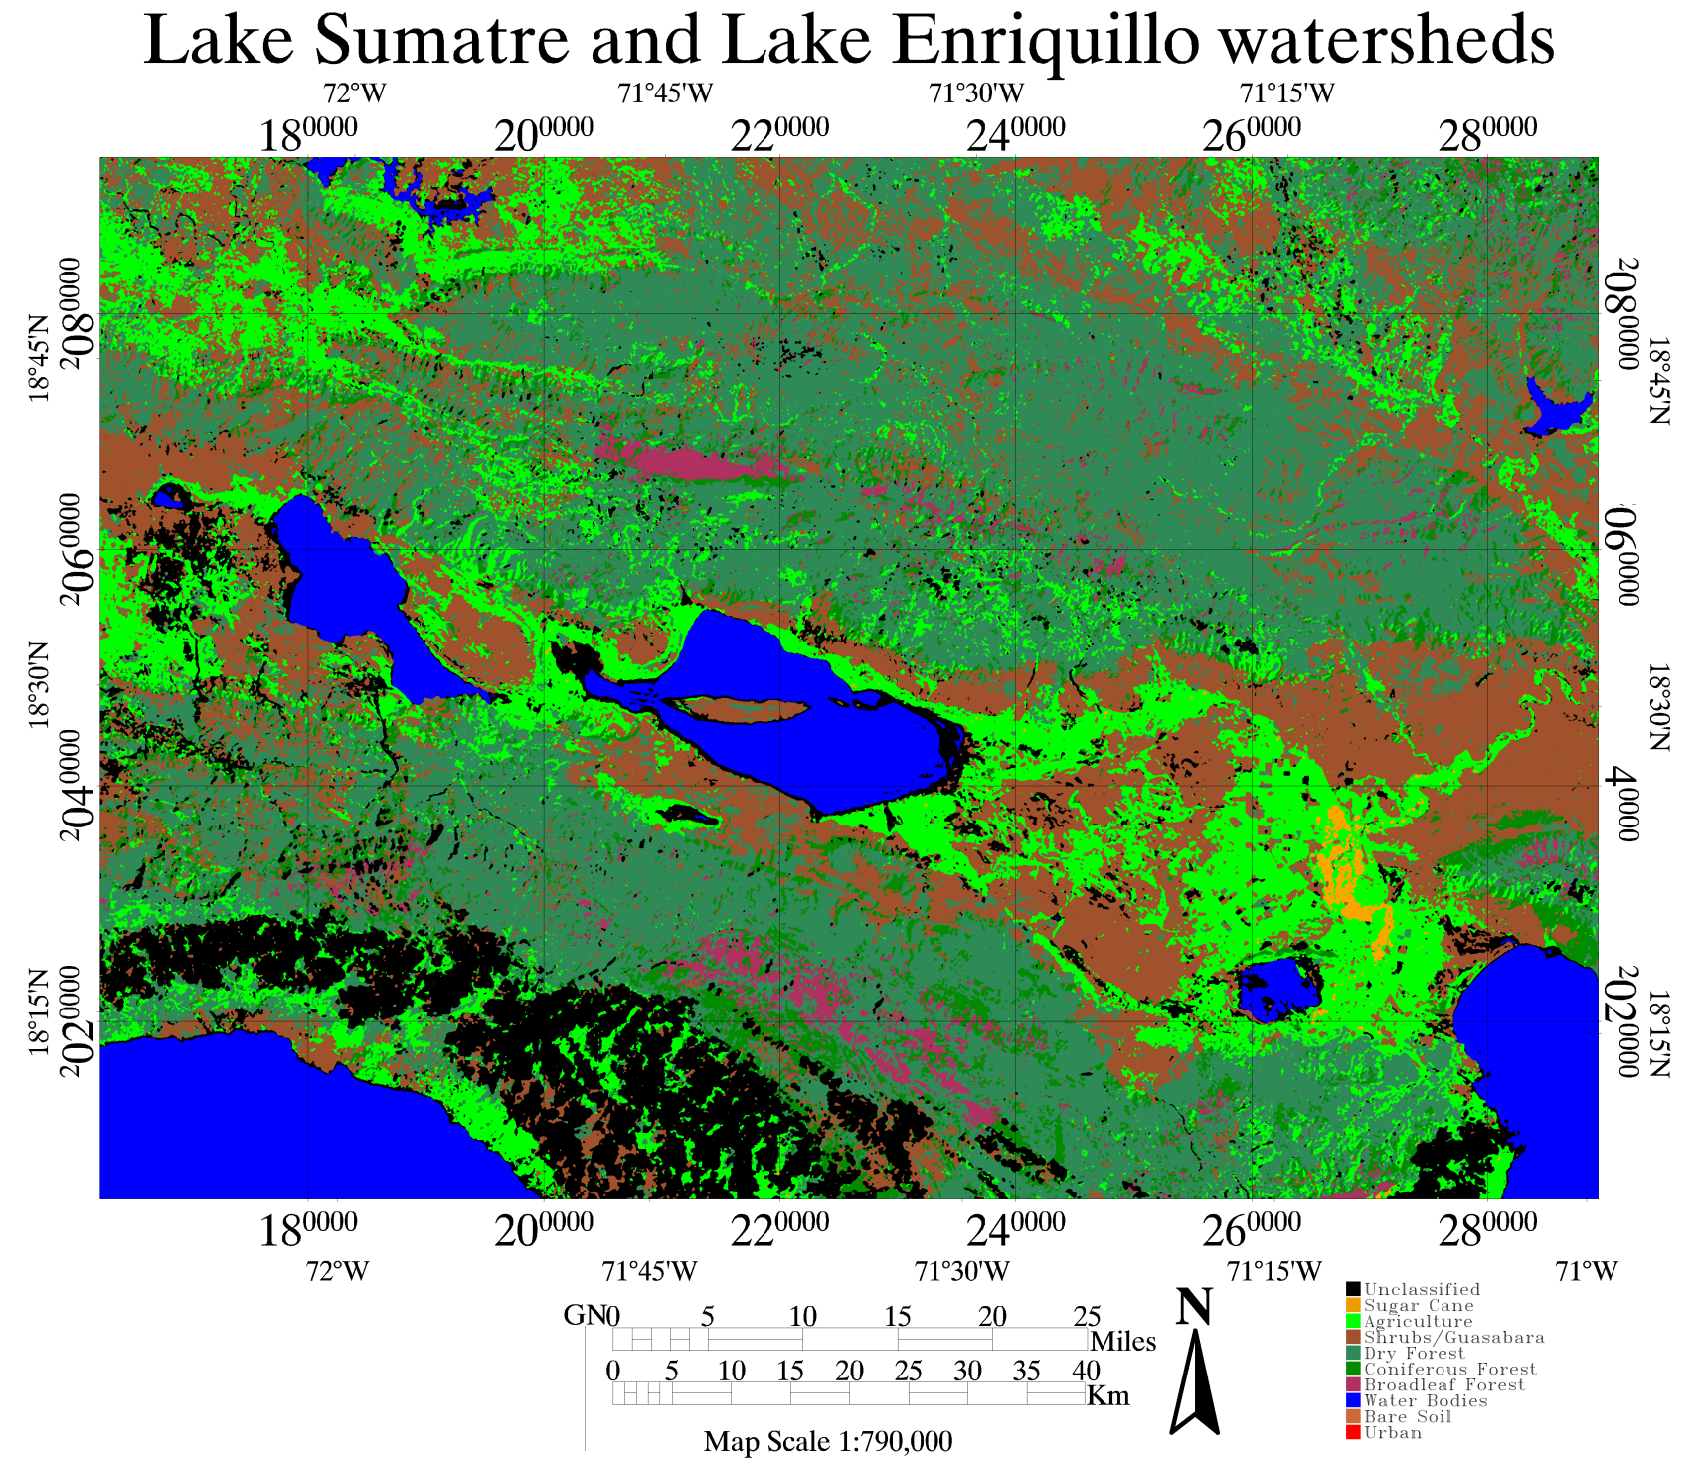
Land Cover and Use Analysis: 1986

Slide 14
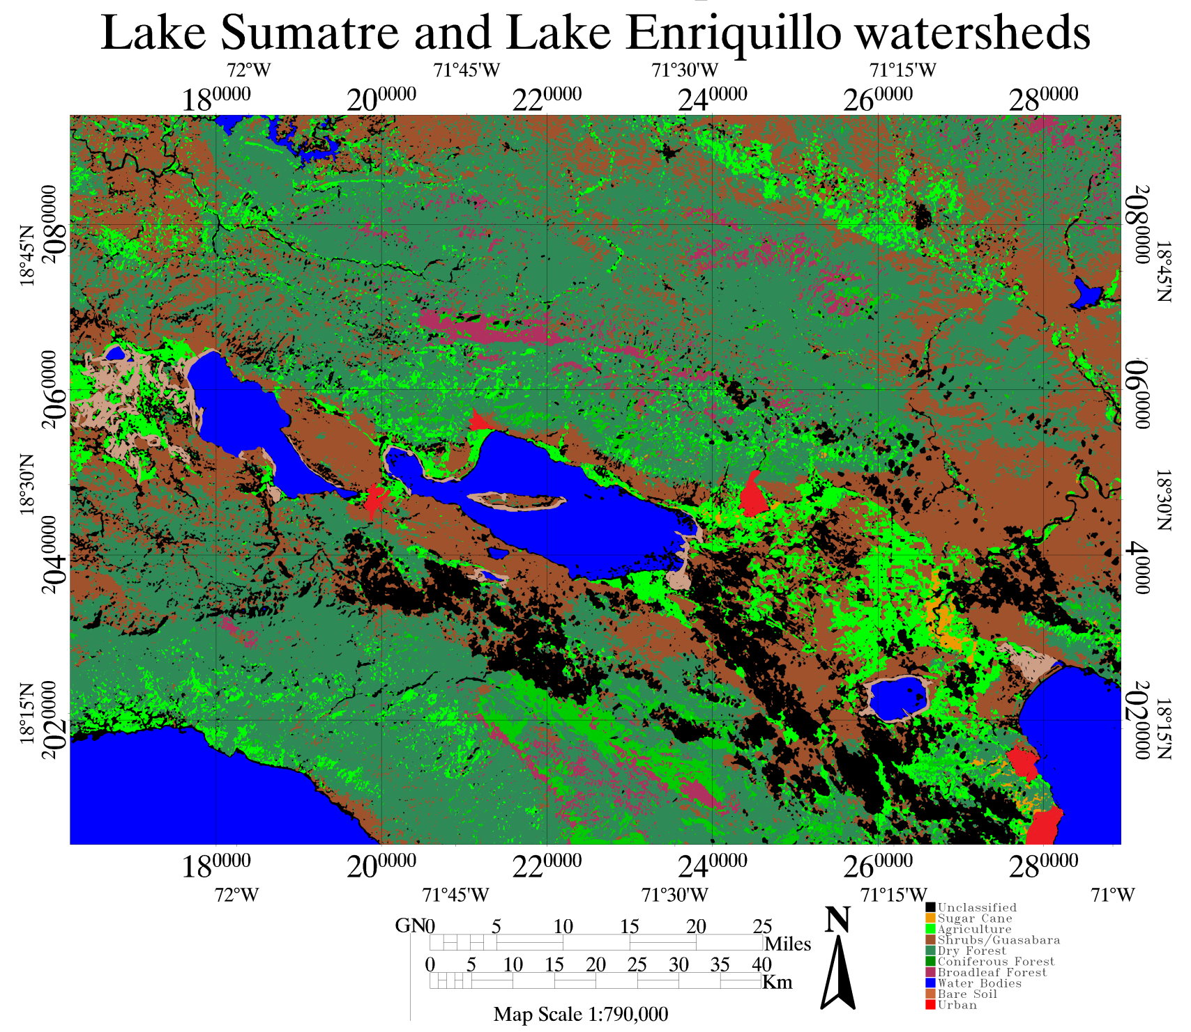
Land Cover and Use Analysis: 2010

Slide 15
Lake Enriquillo Watershed LCLU Changes from 1986-2010
LCLU Analysis performed by MS Eva Luna – Cornell University

Slide 16
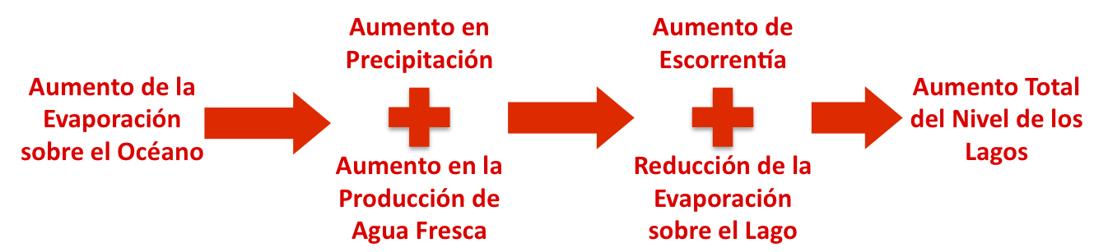
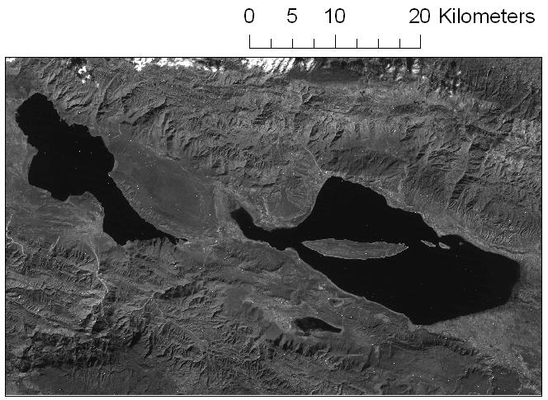
Why is the Surface Area of the Lakes Changing Dramatically?
A Hydro-Meteorology Hypothesis
Increased precipitation
Reduction in evaporation
Increase in Lake surface area
Increase in orographic water production
Increased moisture in the lake area due to increased SSTs surrounding the lake basin
Increasing runoffs due to changes in use of surrounding land and increased precipitation
Increasing fresh water production in the area due to increased horizontal rain produced mainly by orographic cloud formation in the surrounding cloud montane forests
  A combination of these factors could lead to Total Lake Surface Area increase

Slide 17
Why is the Surface Area of the Lakes Changing Dramatically?
A Hydro-Meteorology Hypothesis

Slide 18
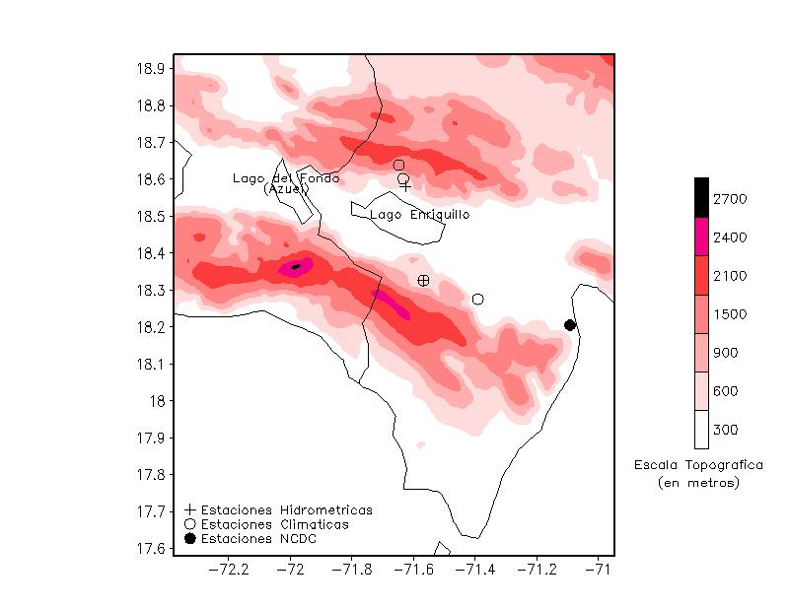
Local Observations:
Hydrological and Climate Surface Stations Location

Slide 19
Why is the Surface Area of the Lakes Changing Dramatically?
A Hydro-Meteorology Hypothesis
Local Climate Data, Barahona Station and Pedernales Peninsula Surrounding Water SST
(10-point running means of daily data for air temps and pcp)
Groundwater measurements at a well located south of Lake Enriquillo

Slide 20
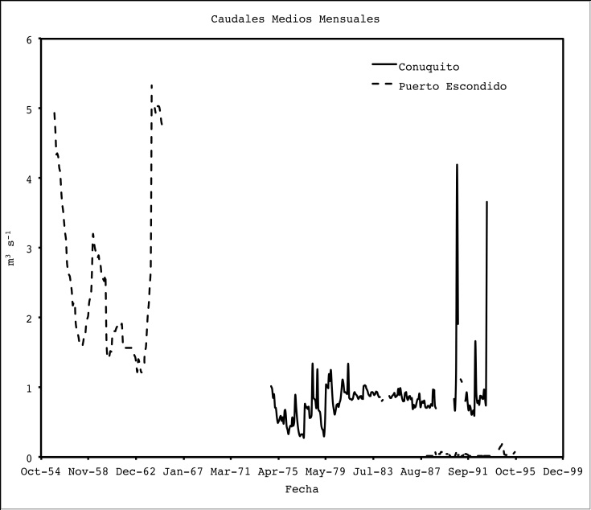
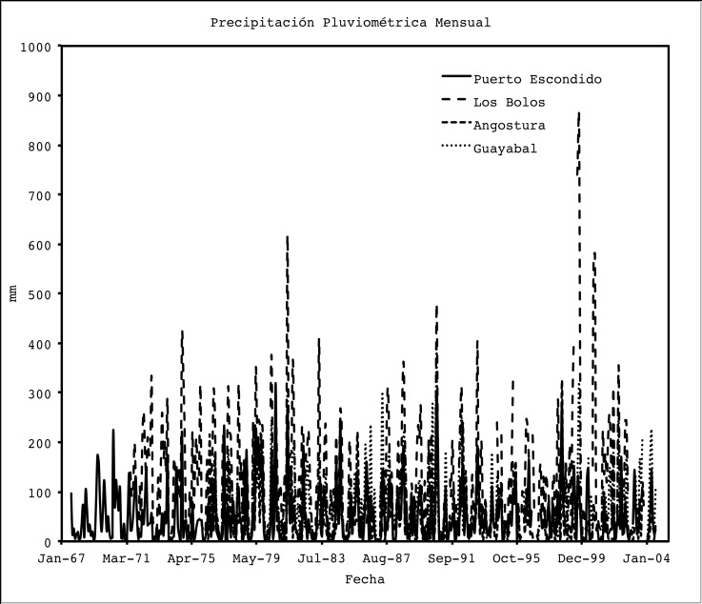
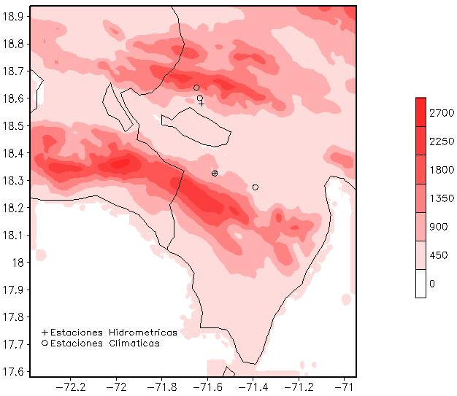
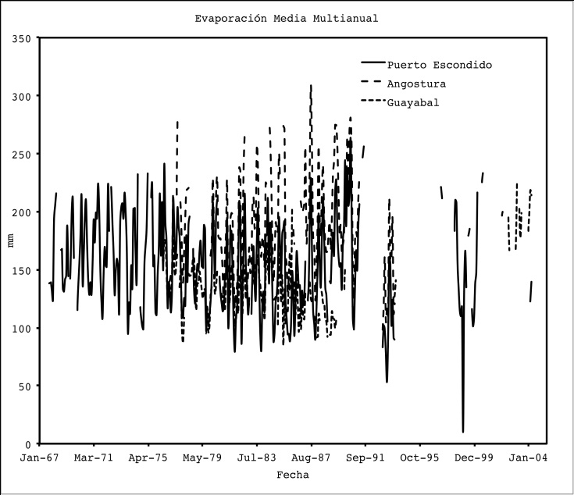
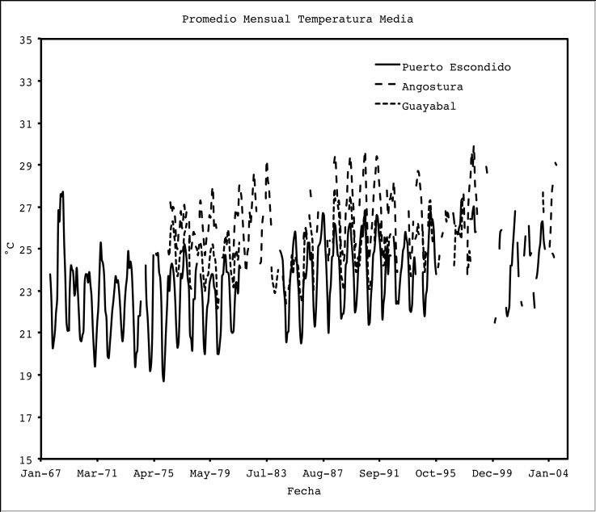
Why is the Surface Area of the Lakes Changing Dramatically?
A Hydro-Meteorology Hypothesis
Stream Flow and Pluvial Precipitation for available stations
INDRHI hydrological and climate surface stations
Evaporation and Air Temperature

Slide 21
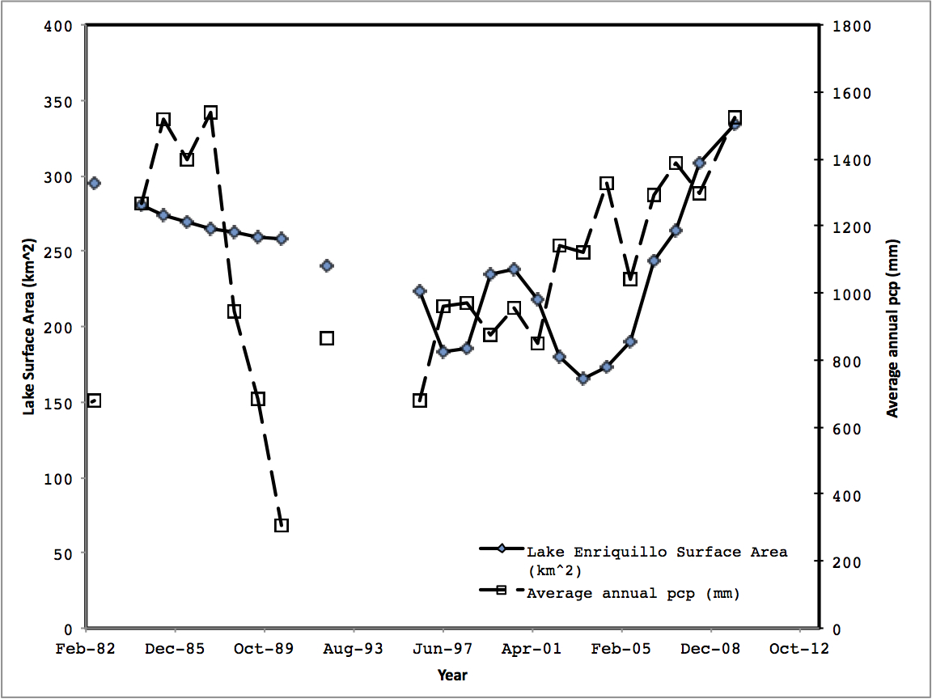
Lake Surface Area & Precipitation Yearly Variation
Observed annual precipitation from Barahona station (NCDC)

Slide 22
Local Observations:
Instrumentation of the Tropical Montane Cloud Forests Surrounding the Lake Basin
The hydro-meteorological hypothesis states that a change in the fresh water production in the sierras plays a key role in the recent growth of the lakes, but due to:
The low hydric and climate station density in the area;
Inadequate temporal coverage for long-term analysis;
Lack of appropriate equipment for key variable measurements;
A network of surface observation station was proposed and deployed.

Slide 23
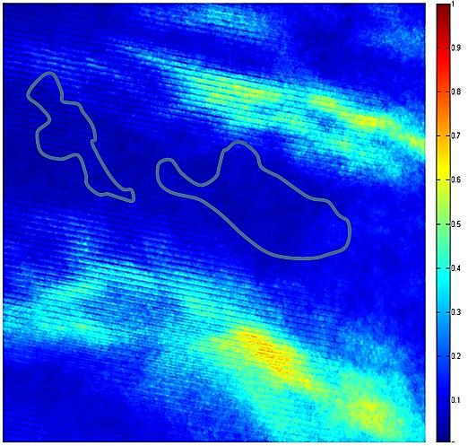
Analysis of Landsat images from past 10 years show cloud frequency north and south of the lake.
Based on Landsat images from 2000-2010
103 images were available (average 10/year)
The color bar indicates how frequent cloud pixels appeared in that location in the available images
Cloud activity in the south is relatively high

Slide 24
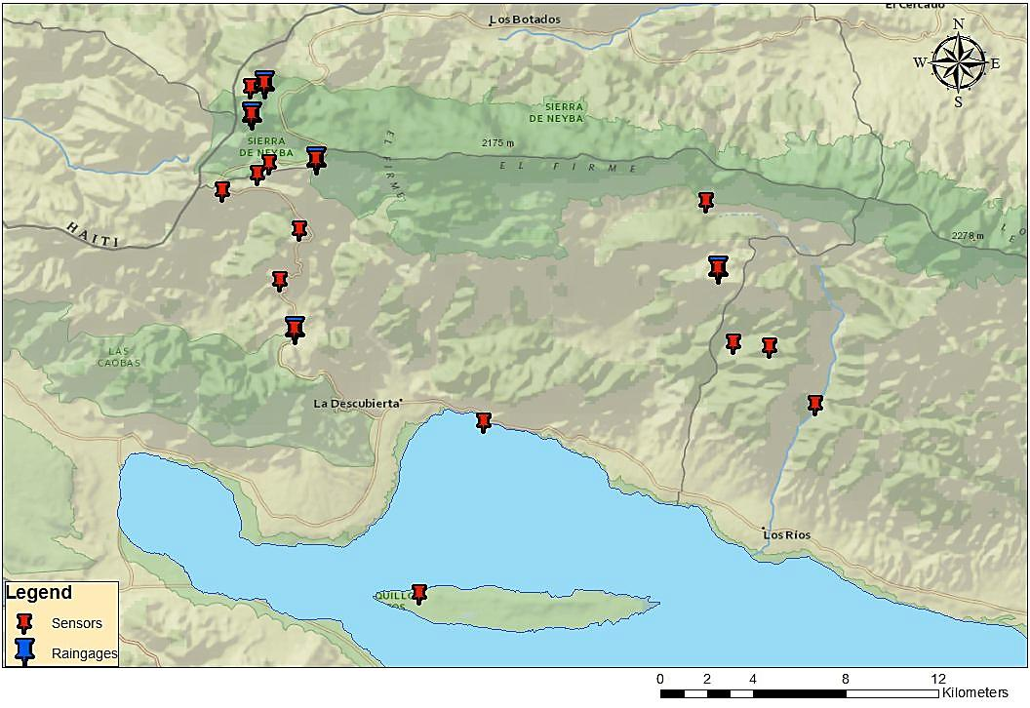
Sensor placement along the Neyba Sierra from the February 2012 field campaign.

Slide 25
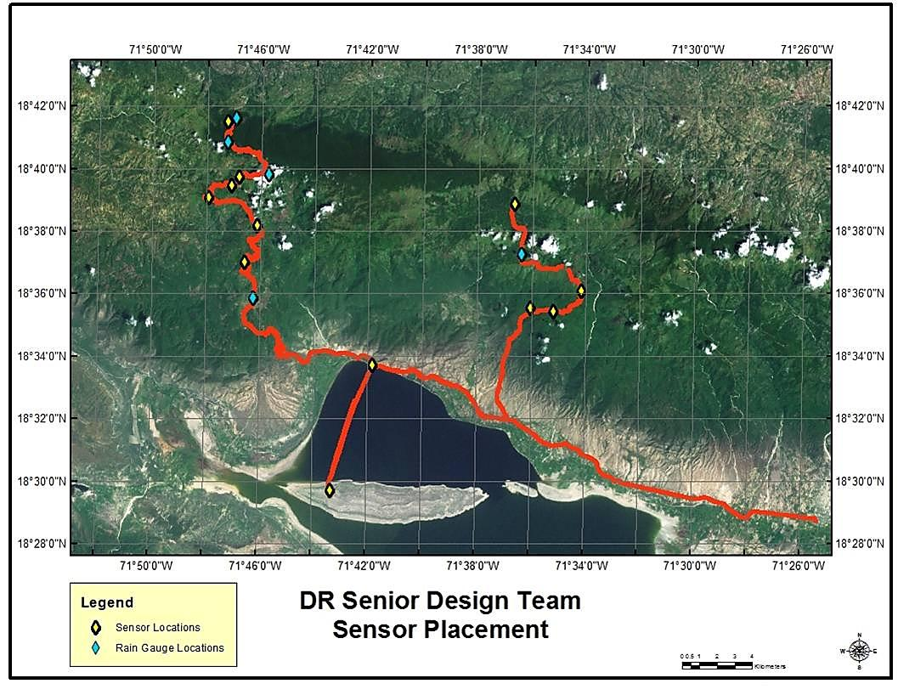
In order characterize the region, the sensors were placed along 2 paths.

Slide 26
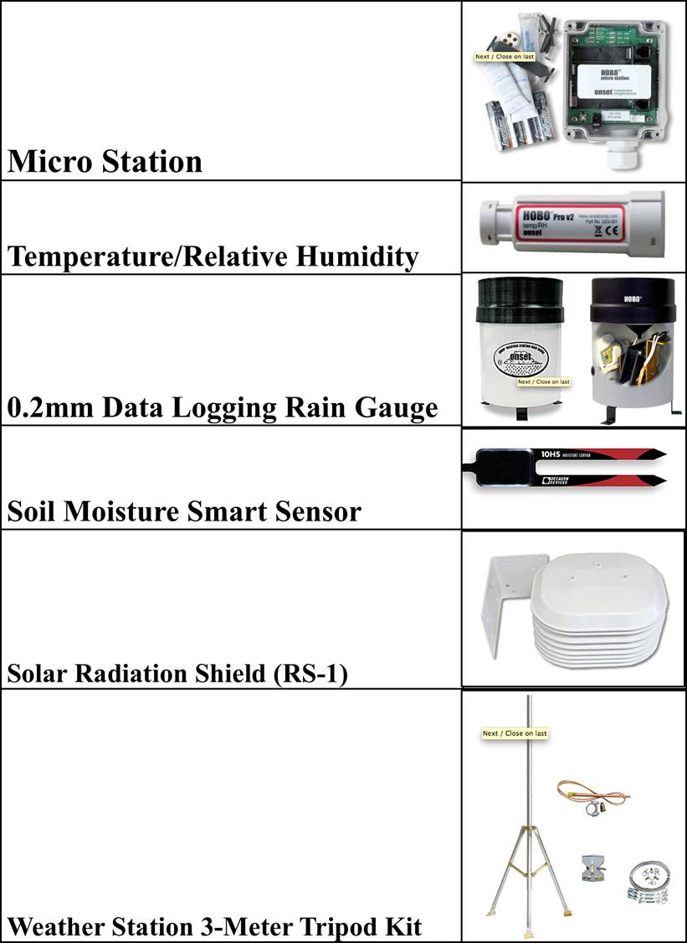
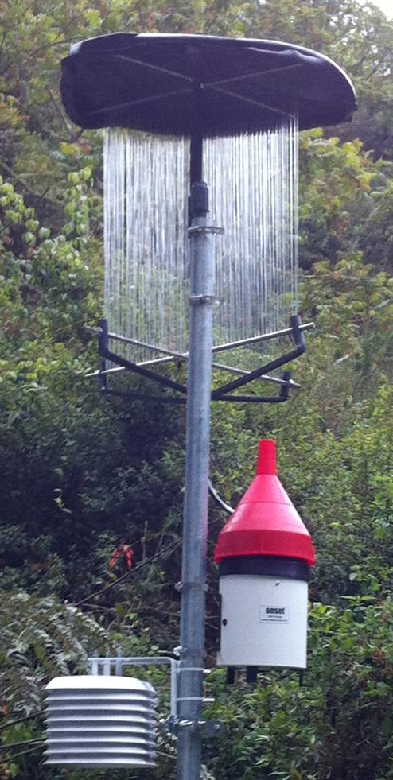
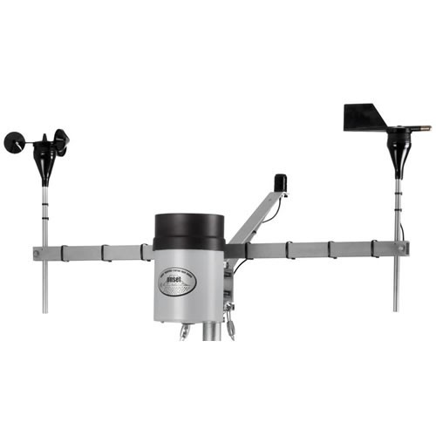

Instrumentation of the Neyba Sierra:
Equipment Used – Deployment Feb. 2012
Fog Gauge Apparatus (modified rain gauge)
Photosynthetically Active Radiation
Wind speed and direction sensors

Slide 27
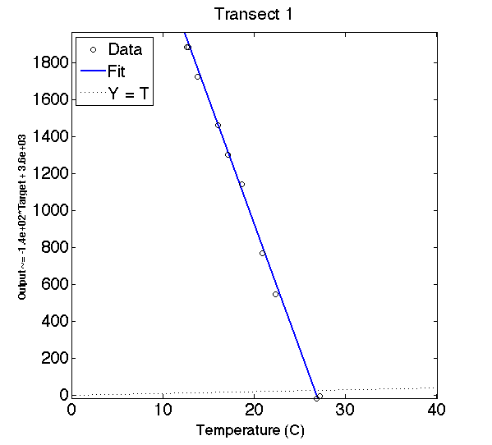
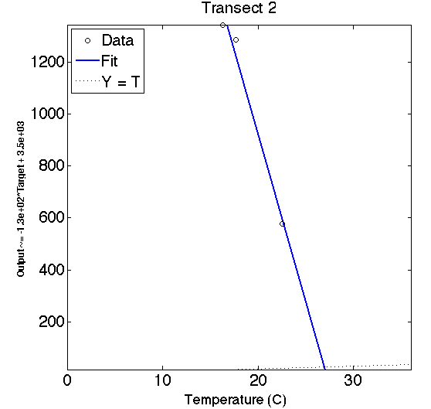
Instrumentation of the Neyba Sierra:
Averaged Temperature Lapse Rate (˚C) for La Descubierta and Los Ríos Paths

Slide 28
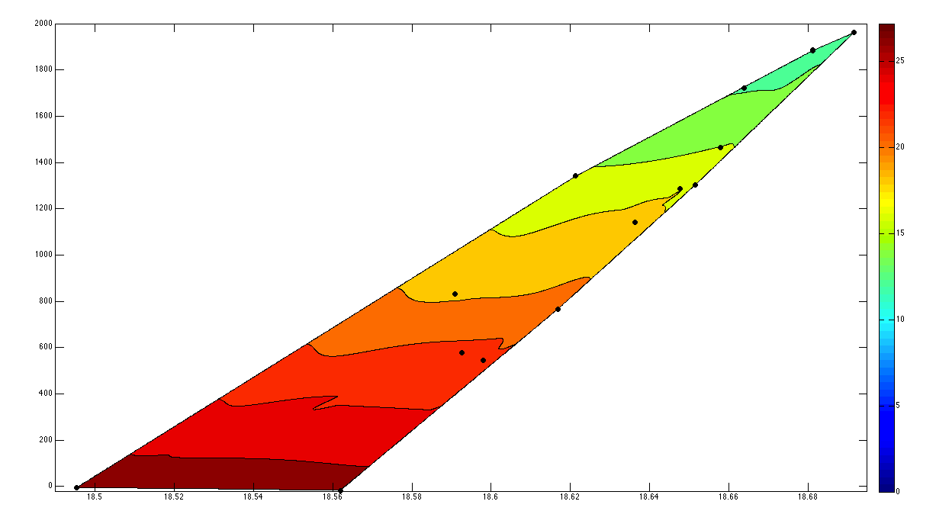
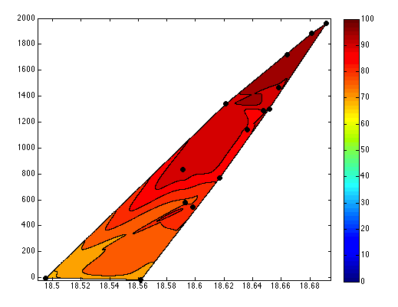
Instrumentation of the Neyba Sierra:
Averaged Temperature and Humidity Profiles
Temp (˚C)
RH (%)

Slide 29
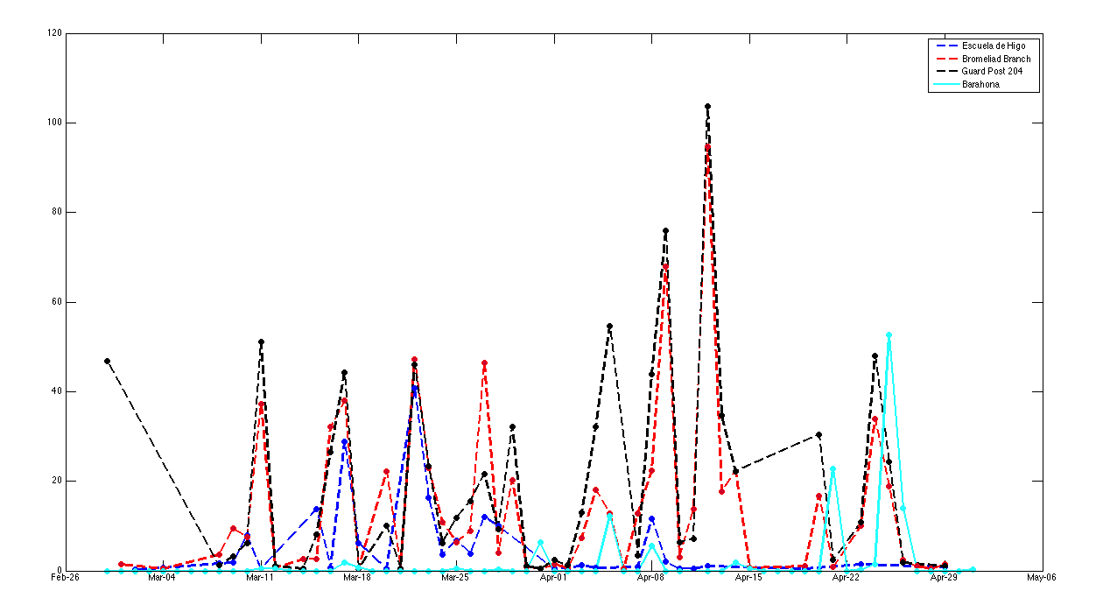
Instrumentation of the Neyba Sierra:
Daily Total Precipitation (mm day⁻¹)

Slide 30
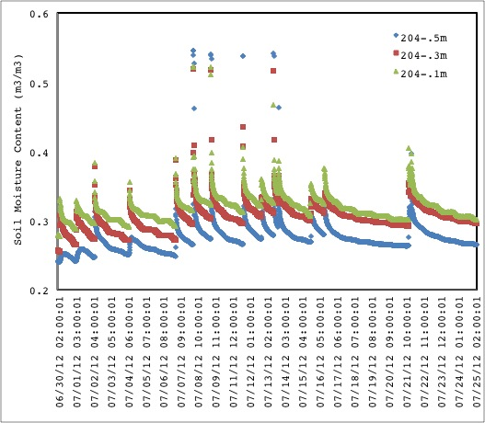
Soil Moisture (Guard Post-204)

Slide 31
Sensors recommended for a more complete lake analysis/characterization, in addition to expanding the network to the Bahoruco Sierra
Evapotranspiration
At the lake
Climate
Sap-flux
Salinity sensor/equipment
Rain gauges
Xylem pressure potential
Dendrometer
Lake level sensor/monitor
Fog gauges
Wind speed/direction
Photosynthetically Active Radiation (PAR) sensors
Soil moisture

Slide 32
A Hydro-Meteorology Hypothesis Tested with Atmospheric Modeling
The regional and local observations are complemented by a set of numerical atmospheric simulations that allow to:
Generate a gridded dataset of key variables;
Incorporate the effects of climate change;
Incorporate the effects of SST change;
Incorporate the effects of LCLU changes;
Generate valuable datasets of variables not easily measured (e.g., atmospheric liquid water content, wind patterns);
This done both at specific peirods of lake growth and shrinkage, and for the complete period of satellite observations.

Slide 33
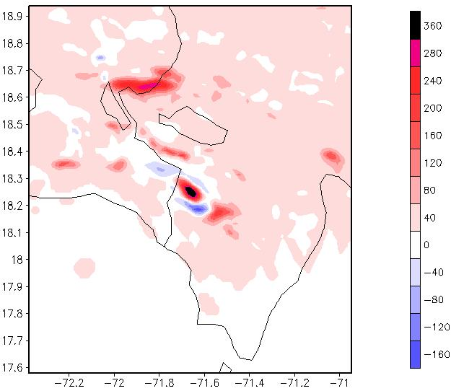
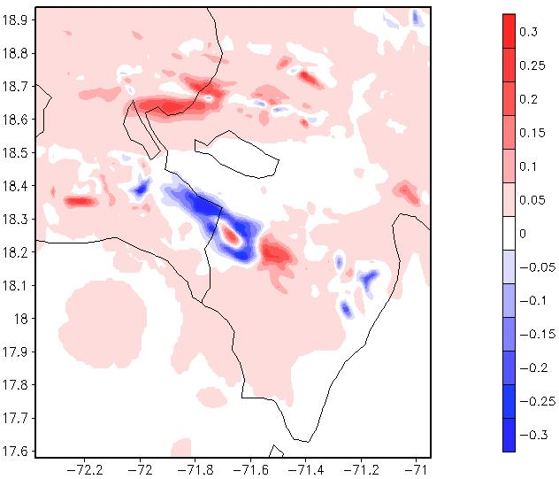
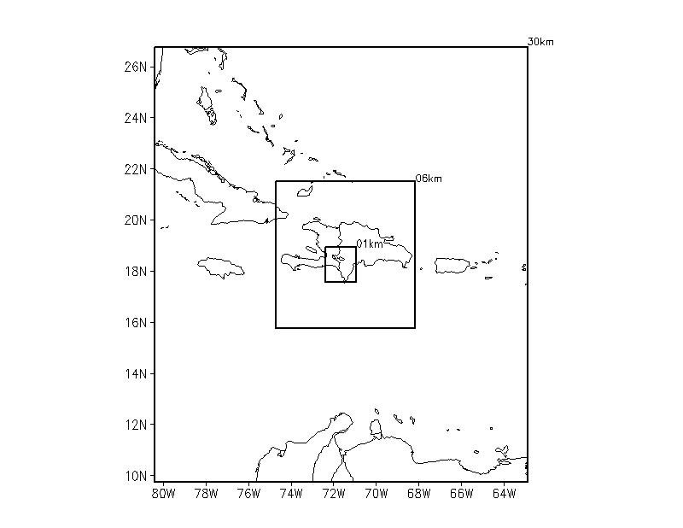
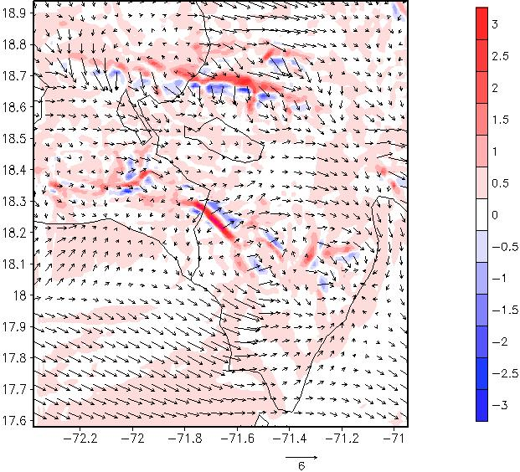
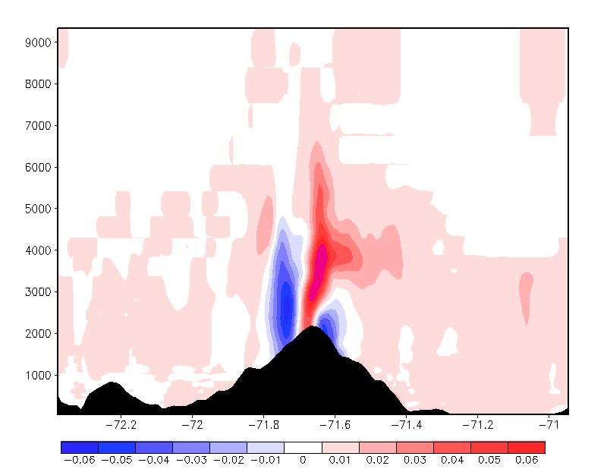
A Hydro-Meteorology Hypothesis Tested with Atmospheric Modeling:
Preliminary Results for Differences in Key Variables
Total surface precipitation and Total liquid water content between 700-1500 m
April 2004 (Lowest Point) and 1995 (Shrinking Period)
Modeling grids showing horizontal resolution of each.
Averaged surface wind (vectors) with vertical motions (contours) and Total liquid water content along cross-section at 18.25 N Lat.

Slide 34
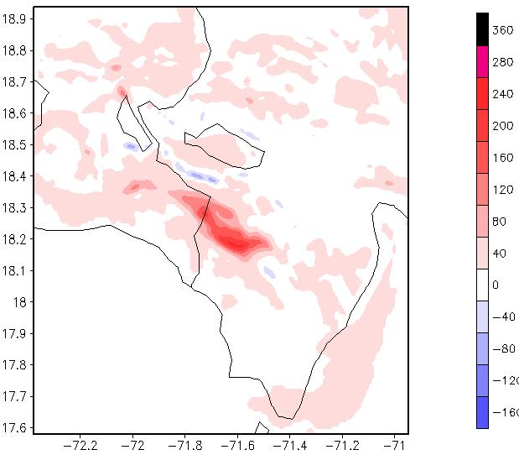
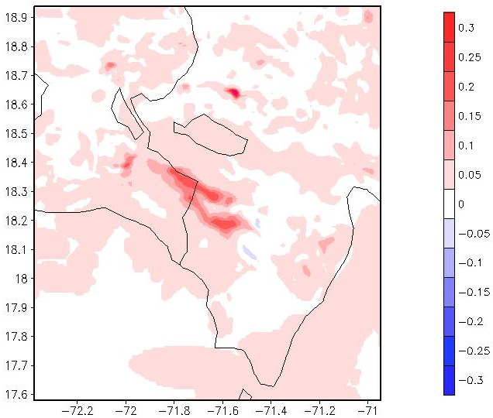
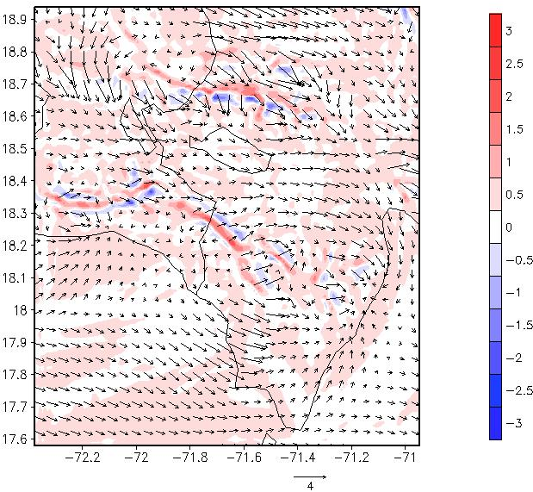
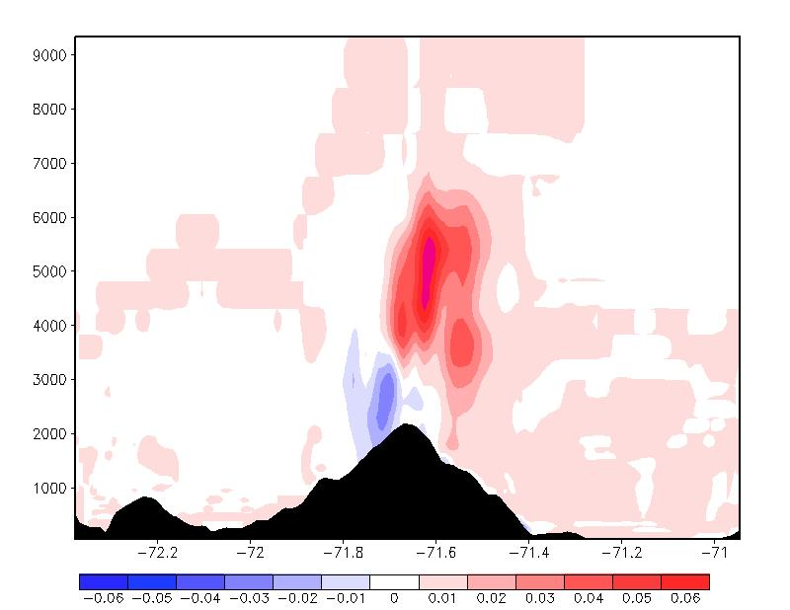
A Hydro-Meteorology Hypothesis Tested with Atmospheric Modeling:
Preliminary Results for Differences in Key Variables
Total surface precipitation and Total liquid water content between 700-1500 m
April 2010 (Growth) and 1995 (Shrinking Period)
Modeling grids showing horizontal resolution of each.
Averaged surface wind (vectors) with vertical motions (contours) and Total liquid water content along cross-section at 18.25 N Lat.

Slide 35
Upcoming modeling exercises recommended for a more complete lake analysis/characterization
Monthly ERS simulations
Complete 1980-2012 simulation
Hydrological modeling
Perform simulation for April 2012
Incorporate, and update when appropriate, atmospheric conditions, LCLU specifications, SST information, and other variables
Model change in lake water levels performing a simple water balance of the basin/lake/cloud forest
Incorporate LCLU change into current simulations
Incorporate different SST values for the periods simulated
Perform trend analysis and comparison with observations
Lake water level (m) is a function of lake volume [h = f(V)]
Perform a quantitative factor separation analysis (Stein & Alpert, 1978)
Determine statistical significance of differences found

Slide 36
Summary of Findings
Lake Area - Lake expansion back to its size at 1984 in year 2006, and its size at the end of 2012 is 24% historically larger.
Precipitation has risen above seasonal averages for 2004 to 2011 showing correlation with lake area increases.
Both land surface temperature and sea surface temperature have been increasing very fast during the last decade resulting in increasing moisture contents in the basin.
Increase in precipitation, SSTs, and moisture content, lead to hypothesized of increases in horizontal rain production.
Land Usage – No significant land use changes were found that could contribute to increases in runoff.

Slide 37
Recommendations For Future Studies
Measurements to test the hypothesis
  Horizontal water production
  Mountain clouds over Sierras
  Bathymetry
  underground inflow
  Water salinity
Further study of extreme events (rain events which produce flooding) frequency correlations with sea surface temperature.
Projections via modeling to the future with emphasis on impacts of Caribbean climate changes due to global warming on Lakes Watershed.
Resources are needed to extend these works.

